Slide 1


Thermal Conductivity Calculation of Argon
by Molecular Dynamics
Yang Zhou
@ Fudan University

Slide 2
Introduction
实验目的：
深入理解分子动力学模拟
解热传导过程涉及的基本物理知识，熟悉计算热导率的不同算法。
掌握热传导过程分子动力学模拟的核心控制参数与模拟步骤。
分析影响热导的物理因素（声子平均自由程、温度效应、尺寸等）。
本课程共8次课： 1-3次课为周阳讲授，4-8节为动手实验环节
助教： 周阳
办公室：物理楼224
邮箱：13110190020@fudan.educn
手机: 18502380069
微信：sipianyezi2006

Slide 3
Basic Methods: Molecular Dynamical Simulation

Slide 4
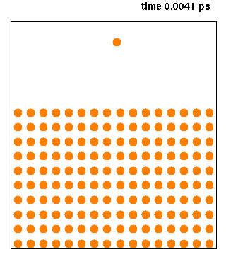
What & Why
Molecular Dynamics(MD) is a commonly used method to study N-body systems.
It can be used to study
Solar systems or universe
Atoms groups or solid, gas and liquid, DNA and even plasma under classical assumption.
Birds or other cluster systems
Equilibrium systems
Highly non-equilibrium systems
Statics
Correlation
Evolution

Slide 5
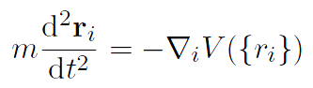
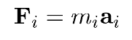
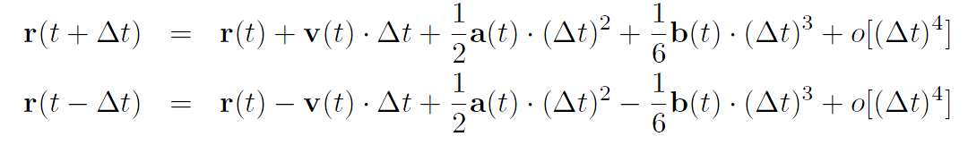
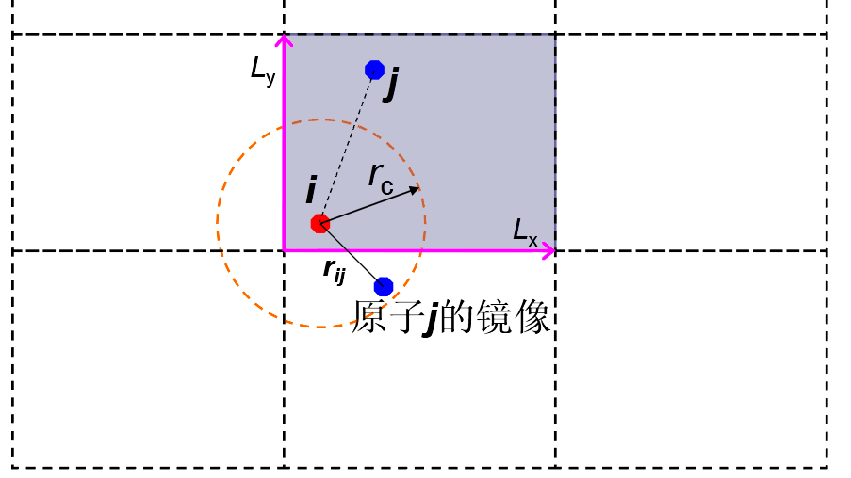

Conceptions
Dynamical Equation
$$⇒$$
Verlet algorithm
Structure & Boundary
Image of j

Slide 6
Conceptions
Neighbor list
In order to reduce the calculation complexity of force from O(N^2) to O(N) , these could be done:
cut off the potential, so we can only calculate the summation over the atoms within the sphere.
save the atoms within the sphere and there’s no need to search the spheres for M steps.
when search for spheres after the M steps, there’s no need to find all the atoms within the sphere, but remove the atoms leaved and add the atoms get close
find neighbor
build neighbor list
update neighbor list

Slide 7
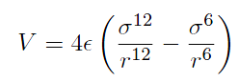
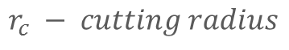
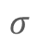
Conceptions
Potential
Lennard-Jones (LJ) Potential
r_{c}
$$σ$$
$$r_{c} − cutting radius$$
Velocity Distribution
Gaussian distribution of Temperature T
Clear out the drift and remaining rotation

Slide 8
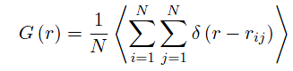
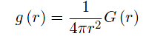
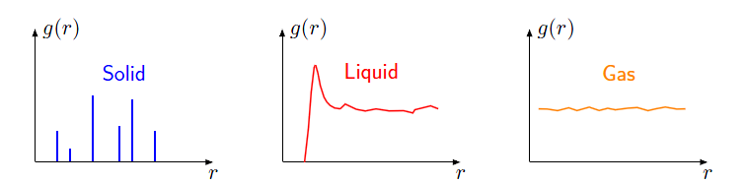
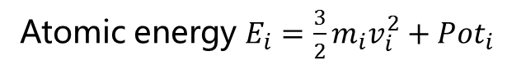
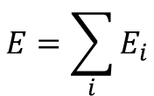
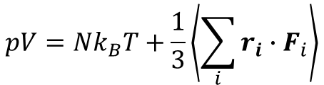
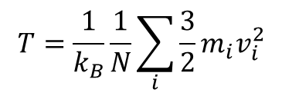
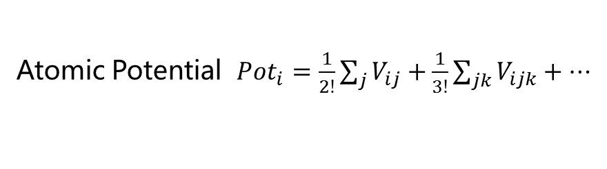
Properties
Energy
$$E=\sum_{i}{E_{i}}$$
Atomic energy $E_{i}=\frac{3}{2}m_{i}v_{i}^{2}+Pot_{i}$
Atomic Potential $Pot_{i}=\frac{1}{2!}\sum_{j}{V_{ij}}+\frac{1}{3!}\sum_{jk}{V_{ijk}}+⋯$
Temperature
$$T=\frac{1}{k_{B}}\frac{1}{N}\sum_{i}{\frac{3}{2}m_{i}v_{i}^{2}}$$
$$pV=Nk_{B}T+\frac{1}{3}\left\langle \sum_{i}{r_{i}∙F_{i}}\right\rangle$$
Pressure
Virial Thorem
Radial distribution function(RDF)
Pair-Correlation function

Slide 9
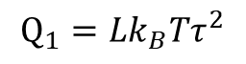
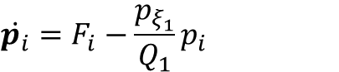
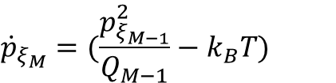
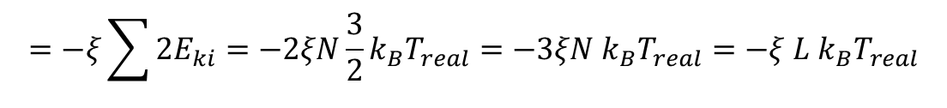
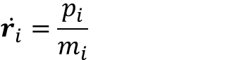
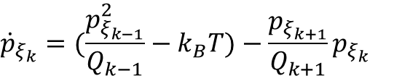
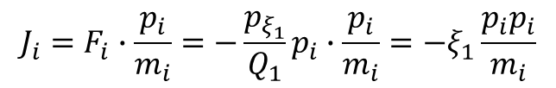
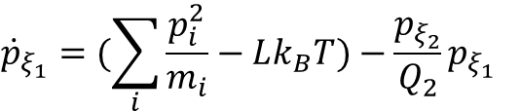
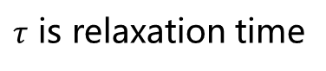
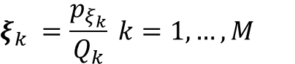
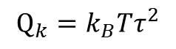
NVT Ensemble
$$\dot{r_{i}}=\frac{p_{i}}{m_{i}}$$
$$\dot{p_{i}}=F_{i}−\frac{p_{ξ_{1}}}{Q_{1}}p_{i}$$
Feedback force
$$ξ_{k} =\frac{p_{ξ_{k}}}{Q_{k}} k=1,…,M$$
$${\dot{p}}_{ξ_{1}}=(\sum_{i}{\frac{p_{i}^{2}}{m_{i}}−Lk_{B}T})−\frac{p_{ξ_{2}}}{Q_{2}}p_{ξ_{1}}$$
$${\dot{p}}_{ξ_{k}}=(\frac{p_{ξ_{k−1}}^{2}}{Q_{k−1}}−k_{B}T)−\frac{p_{ξ_{k+1}}}{Q_{k+1}}p_{ξ_{k}}$$
Dynamics of Nose-Hoover Chain
$${\dot{p}}_{ξ_{M}}=(\frac{p_{ξ_{M−1}}^{2}}{Q_{M−1}}−k_{B}T)$$
L=3N is degree of freedom(dof)
$$Q_{1}=Lk_{B}Tτ^{2}$$
$$Q_{k}=k_{B}Tτ^{2}$$
$τ$ is relaxation time
The power of heatbath:
$$J_{i}=F_{i}∙\frac{p_{i}}{m_{i}}=−\frac{p_{ξ_{1}}}{Q_{1}}p_{i}∙\frac{p_{i}}{m_{i}}=−ξ_{1}\frac{{p_{i}p}_{i}}{m_{i}}$$
$$=−ξ\sum{2E_{ki}}=−2ξN\frac{3}{2}k_{B}T_{real}=−3ξN k_{B}T_{real}=−ξ L k_{B}T_{real}$$

Slide 10
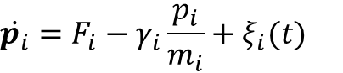
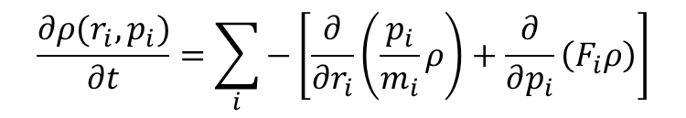
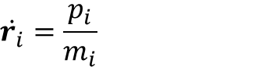
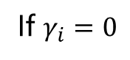
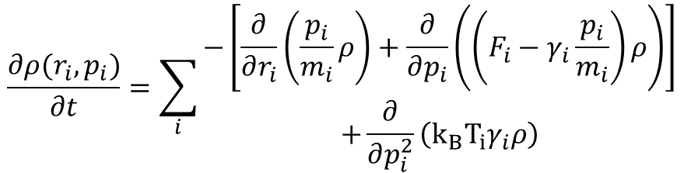
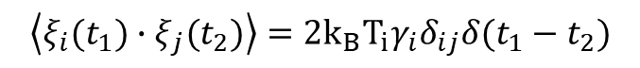
Langevin Ensemble
$$\dot{r_{i}}=\frac{p_{i}}{m_{i}}$$
$$\dot{p_{i}}=F_{i}−γ_{i}\frac{p_{i}}{m_{i}}+ξ_{i}(t)$$
$$\left\langle ξ_{i}(t_{1})∙ξ_{j}(t_{2})\right\rangle =2k_{B}T_{i}γ_{i}δ_{ij}δ(t_{1}−t_{2})$$
Plank-Fokker Equation
$$\frac{∂ρ(r_{i},p_{i})}{∂t}=\sum_{i}{\begin{aligned}−\left[\frac{∂}{∂r_{i}}\left(\frac{p_{i}}{m_{i}}ρ\right)+\frac{∂}{∂p_{i}}\left(\left(F_{i}−γ_{i}\frac{p_{i}}{m_{i}}\right)ρ\right)\right] \\ +\frac{∂}{∂p_{i}^{2}}\left(k_{B}T_{i}γ_{i}ρ\right)\end{aligned}}$$
$$\frac{∂ρ(r_{i},p_{i})}{∂t}=\sum_{i}{−\left[\frac{∂}{∂r_{i}}\left(\frac{p_{i}}{m_{i}}ρ\right)+\frac{∂}{∂p_{i}}\left(F_{i}ρ\right)\right]}$$
If $γ_{i}=0$
Liouville Equation

Slide 11
Properties
Mean square displacement(MSD)
MSD
liquid
solid
time
Velocity autocorrelation function(VACF)
VACF
0
t

Slide 12
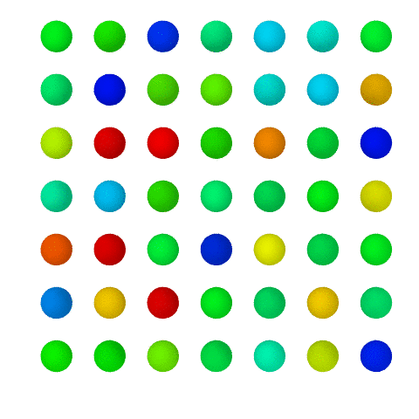
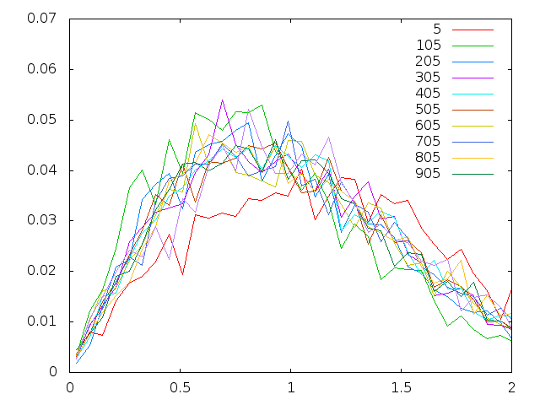
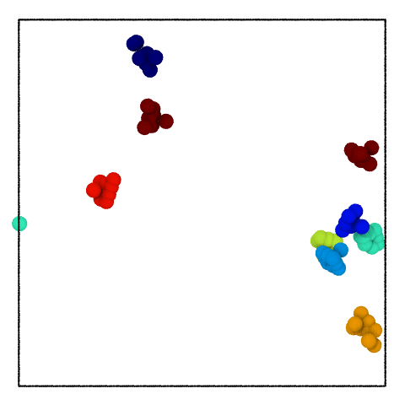
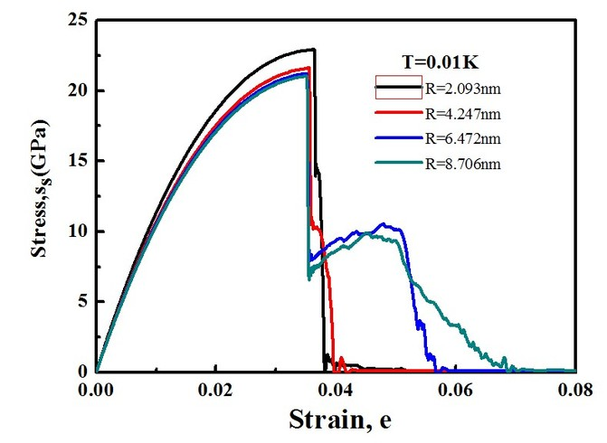
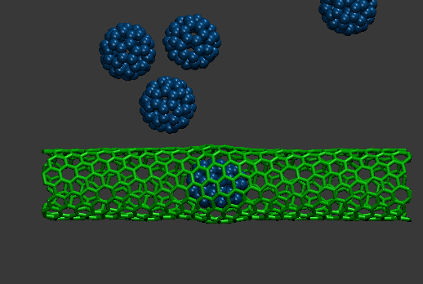
Examples

Slide 13

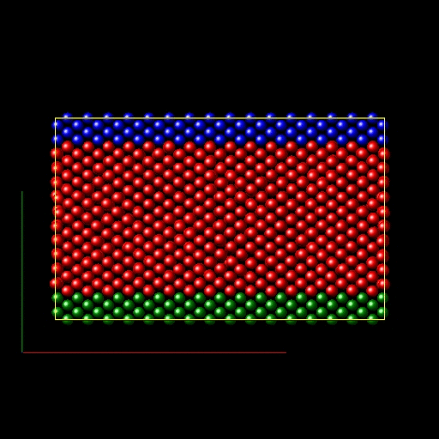
Examples

Slide 14
Homework
编写一个代码，用Verlet算法数值求解N个Ar理想气体原子的牛顿方程
验证玻尔兹曼速率分布

Slide 15
THANK FOR YOUR ATTENTION!
Yang Zhou
@ Fudan University

